Slide 1
Strategies for the Appraiser at VAB
Will Shepherd
General Counsel
Hillsborough County Property Appraiser

Slide 2
Jicarilla Apache Nation v. Rio Arriba County
“Tax assessment is not an exact science, and the outcomes are rarely popular. Using small budgets and limited information, local assessors must make difficult judgments based on uncertain valuations – with the knowledge that higher tax bills are more likely to produce complaints of unfair treatment than thank you cards.”

Slide 3
The Rules
12D-9.020 Exchange of Evidence.
(1)(a)1. At least 15 days before a petition hearing, the petitioner shall provide to the property appraiser a list of evidence to be presented at the hearing, a summary of evidence to be presented by witnesses, and copies of all documentation to be presented at the hearing.
2. To calculate the fifteen (15) days, the petitioner shall use calendar days and shall not include the day of the hearing in the calculation, and shall count backwards from the day of the hearing. The last day of the period shall be included unless it is a Saturday, Sunday, or legal holiday, in which event the period shall run until the end of the next previous day that is neither a Saturday, Sunday, or legal holiday.

Slide 4
The Rules
(2)(a) If the property appraiser receives the petitioner’s documentation as described in paragraph (1)(a), and if requested in writing by the petitioner, the property appraiser shall, no later than seven (7) days before the hearing, provide to the petitioner a list of evidence to be presented at the hearing, a summary of evidence to be presented by witnesses, and copies of all documentation to be presented by the property appraiser at the hearing. The evidence list must contain the current property record card. There is no specific form or format required for the petitioner’s written request.
(b) To calculate the seven (7) days, the property appraiser shall use calendar days and shall not include the day of the hearing in the calculation, and shall count backwards from the day of the hearing. The last day of the period so computed shall be included unless it is a Saturday, Sunday, or legal holiday, in which event the period shall run until the end of the next previous day which is neither a Saturday, Sunday, or legal holiday.

Slide 5
The Rules
(b) A petitioner’s noncompliance with paragraph (1)(a), does not affect the petitioner’s right to receive a copy of the current property record card from the property appraiser as described in Section 194.032(2)(a), F.S.
(c) A petitioner’s noncompliance with paragraph (1)(a), does not authorize a value adjustment board or special magistrate to exclude the petitioner’s evidence. However, under Section 194.034(1)(h), F.S., if the property appraiser asks in writing for specific evidence before the hearing in connection with a filed petition, and the petitioner has this evidence and knowingly refuses to provide it to the property appraiser a reasonable time before the hearing, the evidence cannot be presented by the petitioner or accepted for consideration by the board or special magistrate. Reasonableness shall be determined by whether the material can be reviewed, investigated, and responded to or rebutted in the time frame remaining before the hearing. These requirements are more specifically described in subsection (8), of this rule, and in paragraphs 12D-9.025(4)(a) and (f), F.A.C.

Slide 6
The Rules
  (b) If the property appraiser does not provide the information to the petitioner within the time required by paragraph (2)(b), the hearing shall be rescheduled to allow the petitioner additional time to review the property appraiser’s evidence.

Slide 7
Dictating the Issues
Don’t let the other party dictate the issue of the case.
Don’t get into a debate on a cap rate, when the cost approach (that they didn’t do) is the best approach to value.

Slide 8
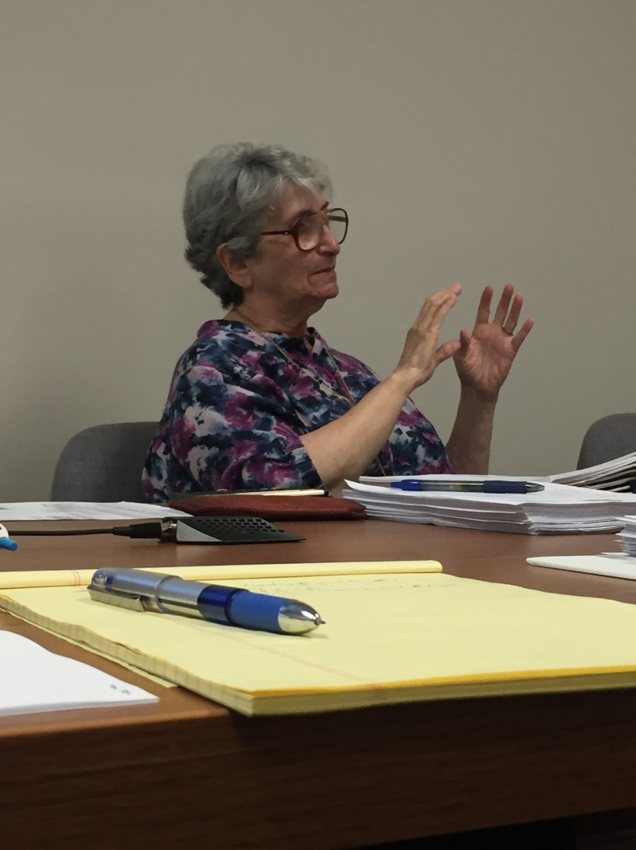
Hearing Etiquette

Slide 9
Hearing Etiquette
Objections to evidence/testimony
  Be reasonable
  Testimony is evidence
Interrupting
  Don’t (unless its an evidence objection)
  Letting them talk is the best strategy
  Take notes/pay attention
  Talk to the Special Magistrate, not the other Party
  You will never convince them
  It will only get ugly

Slide 10
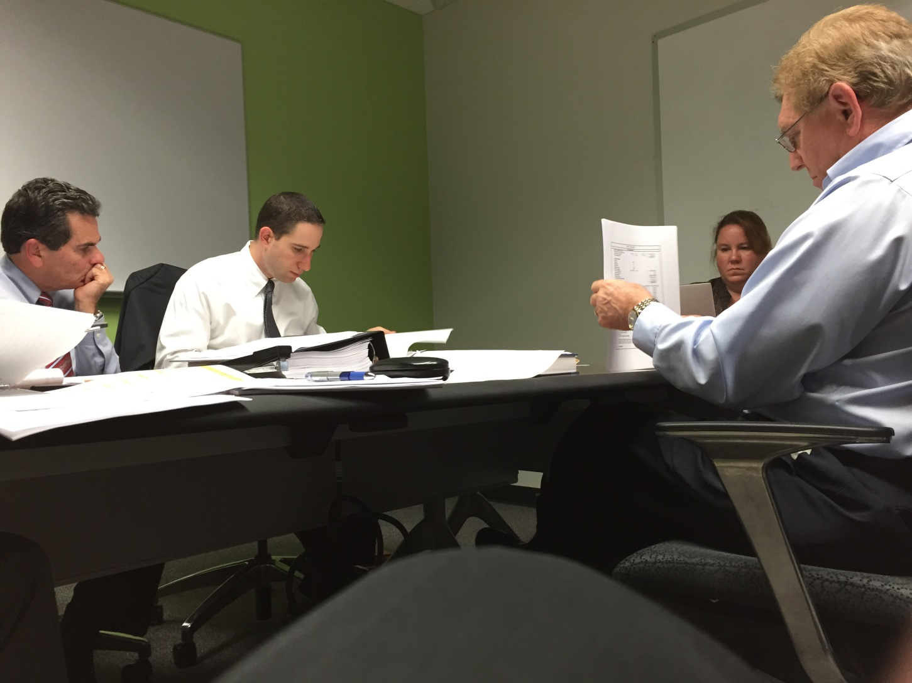
Presentation Skills

Slide 11
Presentation Skills
Address the Special Magistrate, not the other Party
Overview of the Facts (You know the property, the Special Magistrate does not.)
Bullet Points, not paragraphs
Save Rebuttal for… Rebuttal (Don’t anticipate the other side’s argument)
Pictures are worth a thousand words

Slide 12
The 10,000 Ft. View
Step back and look at the big picture
Is the value of the improved property really almost land value?!?
How does the income/sale comparison approaches match up with the cost approach (if reasonably new) or a recent sales price of the subject
Is the property really obsolete if the industry is still building properties with the same design and features?

Slide 13
Defending In Fee
Create a separate analysis
Use additional data
  Sales tax data – DOR
  Articles regarding industry/property
  Texts regarding proper appraisal practices

Slide 14
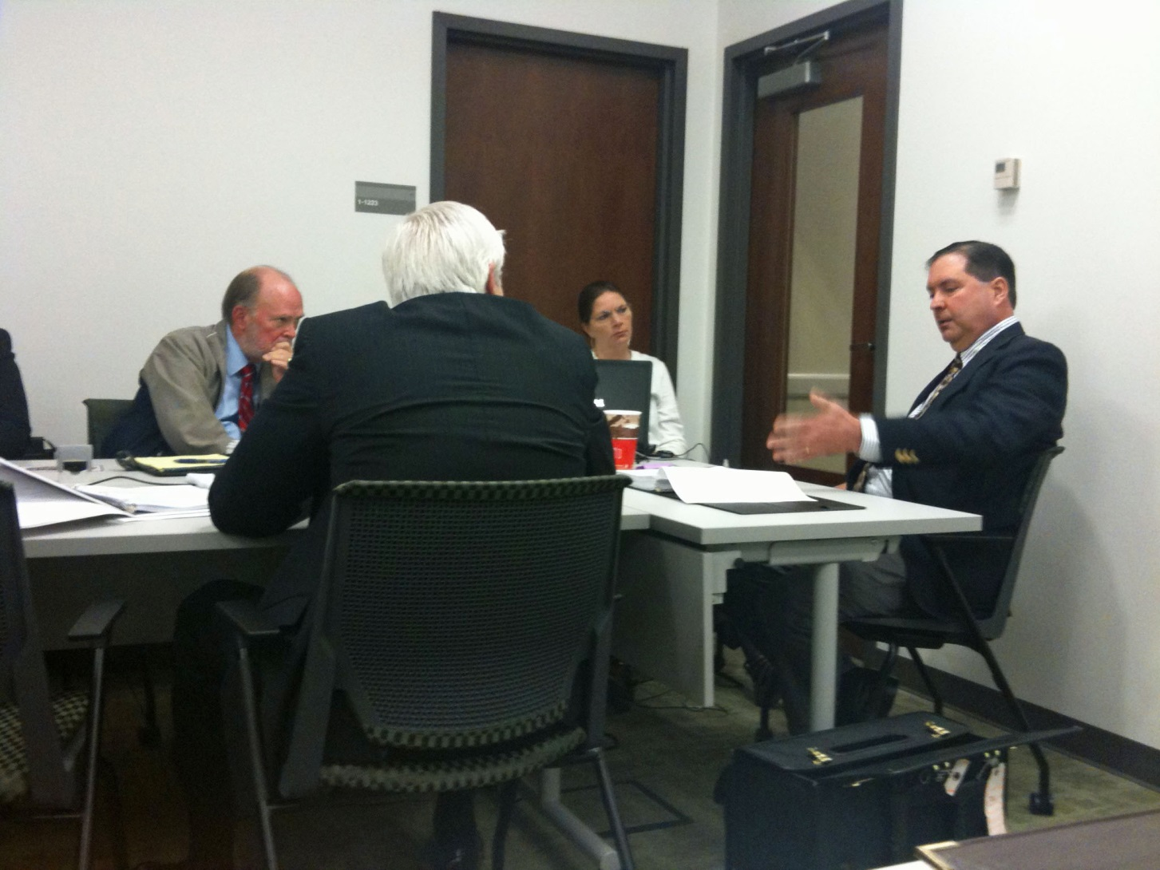
Cross Examination

Slide 15
Cross Examination
Legal Authority for Cross Examination
Why cross examine?
  Presenting your case is not enough
  Elicit testimony as to what they did and considered
  Elicit testimony as to what they did not do and did not consider
  Knowledge of the local market
  Knowledge of the property
  Verified the comps?
  Appraisal designations?

Slide 16
Cross Examination
Other Tips for Cross Examination
  Be polite
  Review their evidence
  Violations of appraisal theory
  Violations of property tax law
  Write down your questions
  Don’t call them out on an error you have also committed

Slide 17
Using Authoritative Texts
You are not an authority
It always has more weight in black and white
  The Appraisal of Real Estate
  Property Assessment Valuation
  Florida Statutes
  Florida case law

Slide 18
Rebuttal – What It is/What It Isn’t
Response to unanticipated facts/argument

Slide 19
Top Five Appraisal and Legal Theories for Use at VAB
Turner v. Bell Chevrolet/Bystrom v. Whitman
  Petition can challenge specific portion of assessment (either physical or single aspect of valuation approach), however, ultimate issue is overall value of the property

Slide 20
Top Five Appraisal and Legal Theories for Use at VAB
Highest and Best Use
  Physically different properties can have different H&BU
  H&BU is all about demand
  Maximally productive – the ignored test

Slide 21
Top Five Appraisal and Legal Theories for Use at VAB
The Hypothetical Buyer (in the hypothetical sale)
  You do not have to identify a buyer
  Is there a demand for the services provided by the property?

Slide 22
Top Five Appraisal and Legal Theories for Use at VAB
Eurofresh, Inc. v. Graham Cnty.
  Obsolescence in the comparables does not equate to obsolescence in the subject.
  Subject – 168 acre hydroponic greenhouse
  40% external obsolescence alleged by owner
  Based on study of 3 other greenhouses (2 not in operation, all 3 sold by lender out of foreclosure or bankruptcy)

Slide 23
Top Five Appraisal and Legal Theories for Use at VAB
Eurofresh, Inc. v. Graham Cnty.
“It is not sufficient… to simply assert that a property’s value should be reduced because of external obsolescence observed elsewhere. Particulary, when, as here, a taxpayer calculates obsolescence based on other ‘comparable’ properties, the taxpayer must prove that the subject property actually is affected by the obsolescence seen in the other properties.”

Slide 24
Costs of Sale/1st and 8th Criteria
DOR is wrong – don’t give up the fight.

Slide 25
Tales from the VAB
A. Tales of Desperation
  1. Trains, Neighbors and Nudists
  2. Down by the River
  B. Under the Table
  1. Herbert Dorf – Toeless Bigamist
  2. Goon Squad/A Kick to the Shins
  C. Weed-phrodisiac
  D. An Eye for an Eye
  1. Putting the Evidence on the Table
  E. The Sleepy Magistrate

Slide 26

The End

